Slide 1
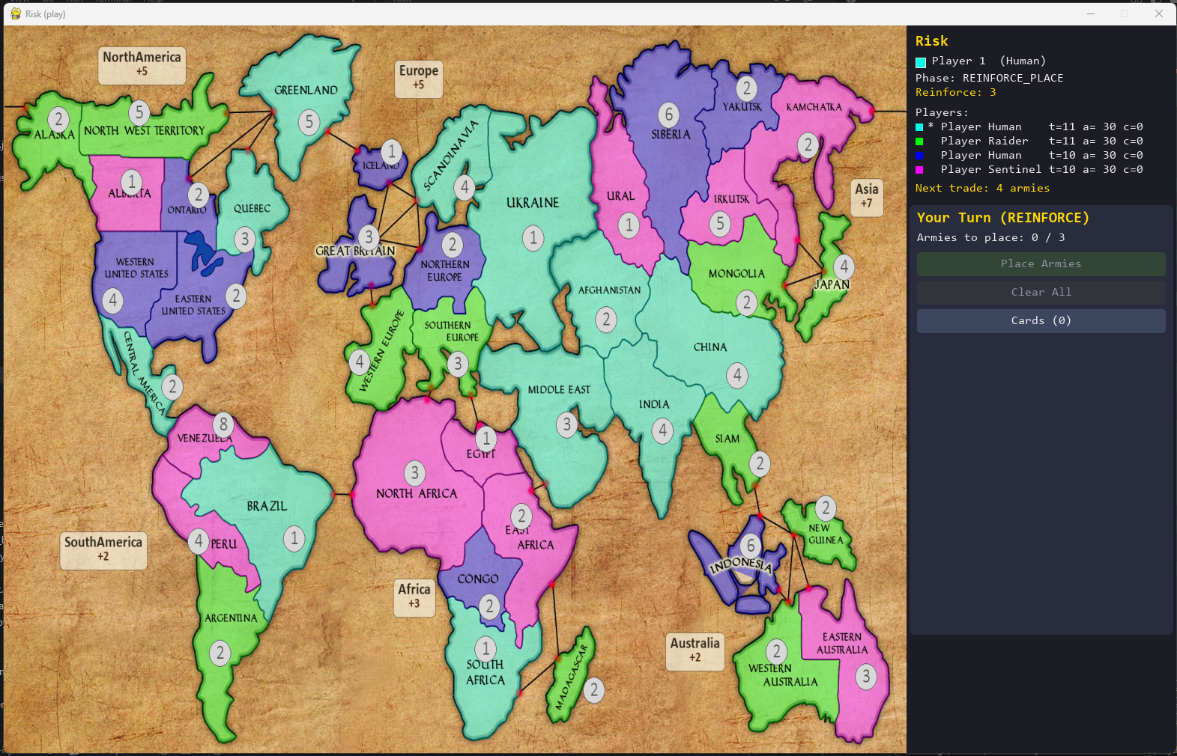

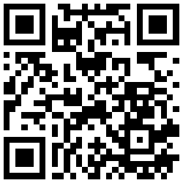

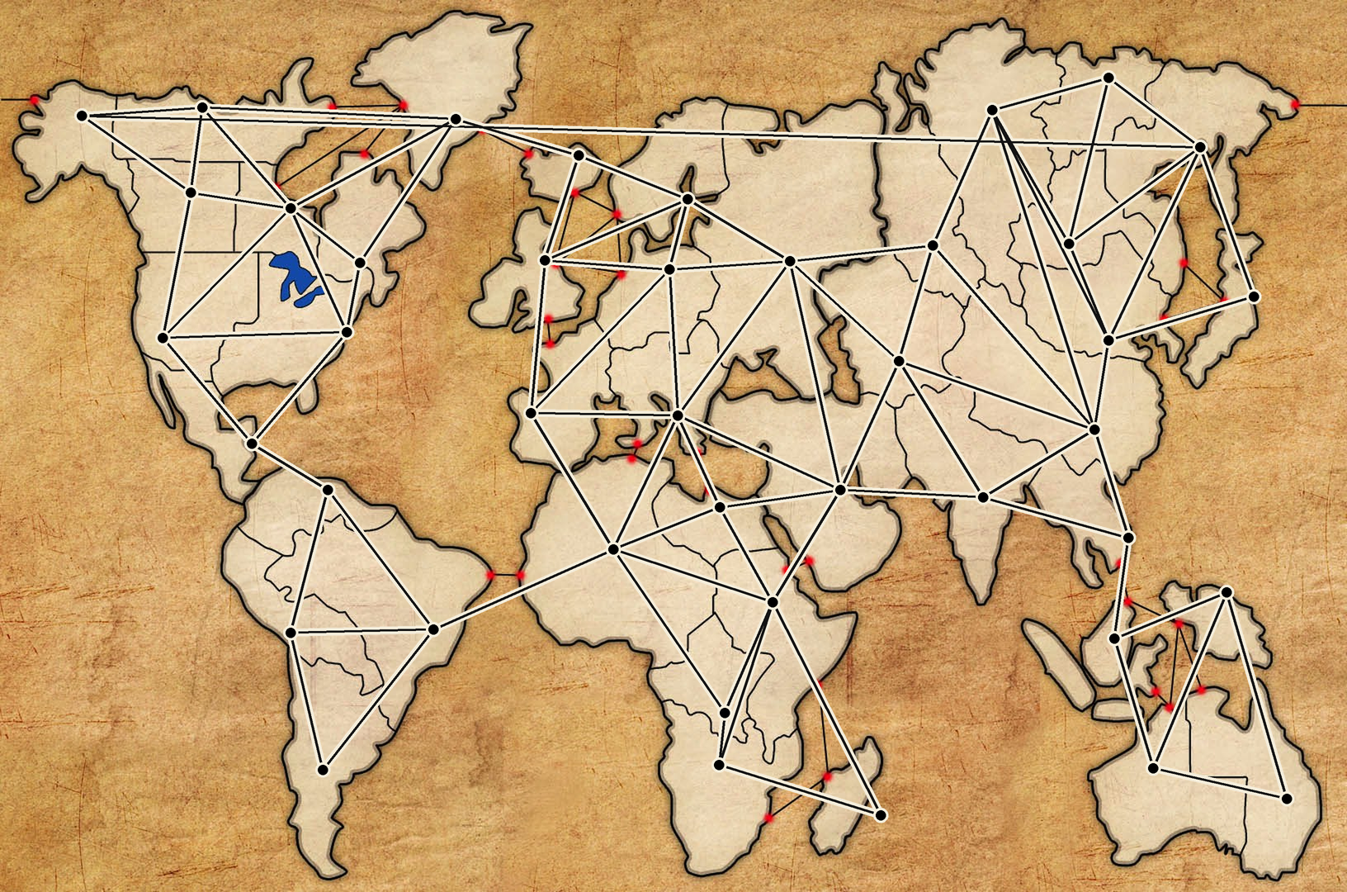
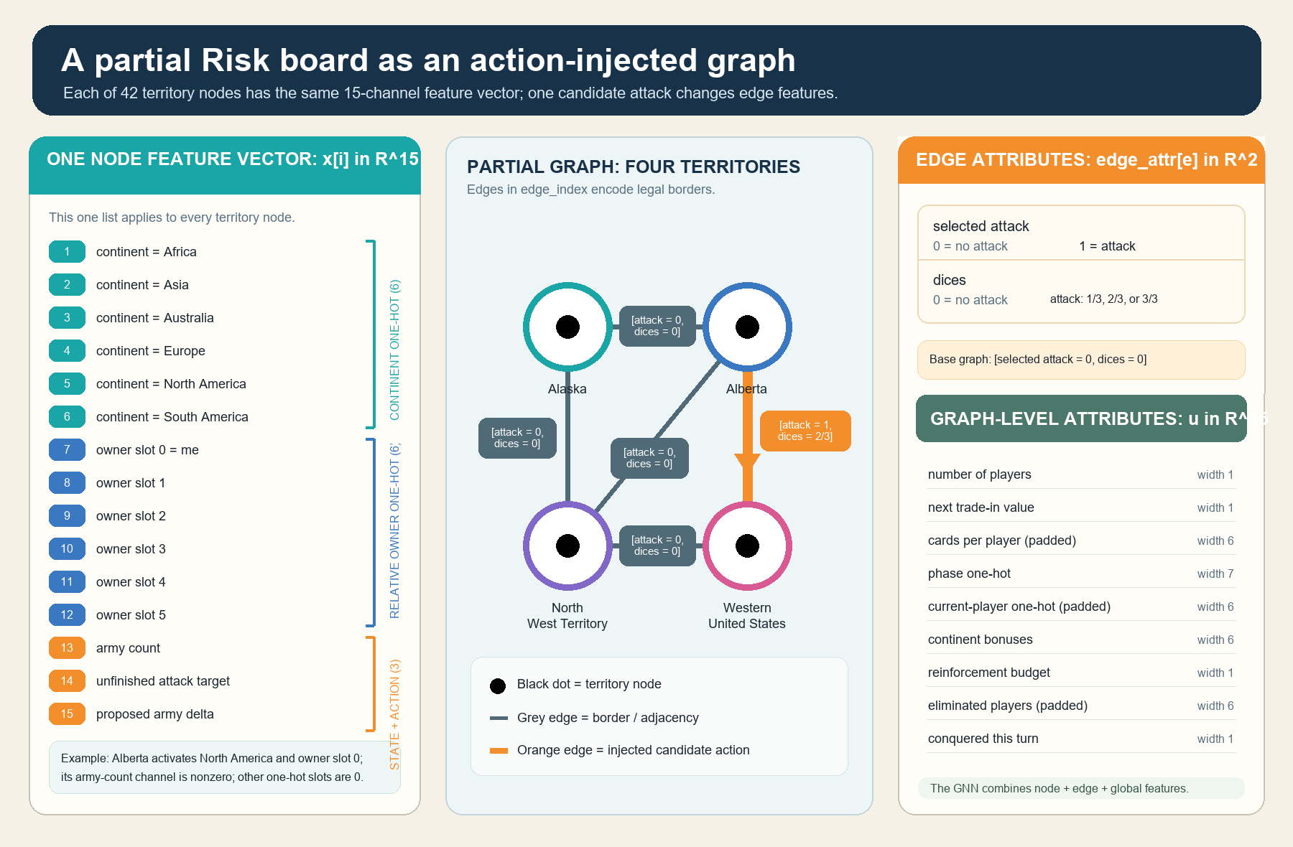
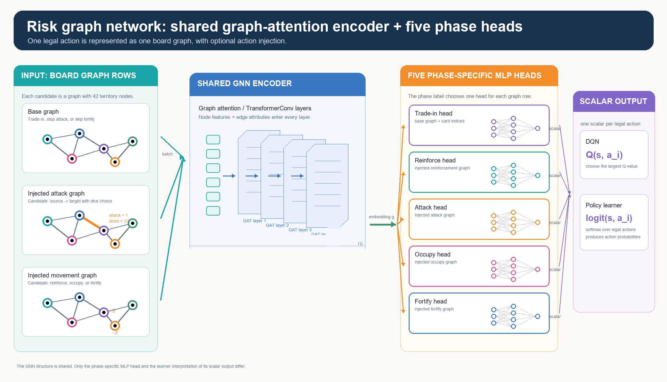
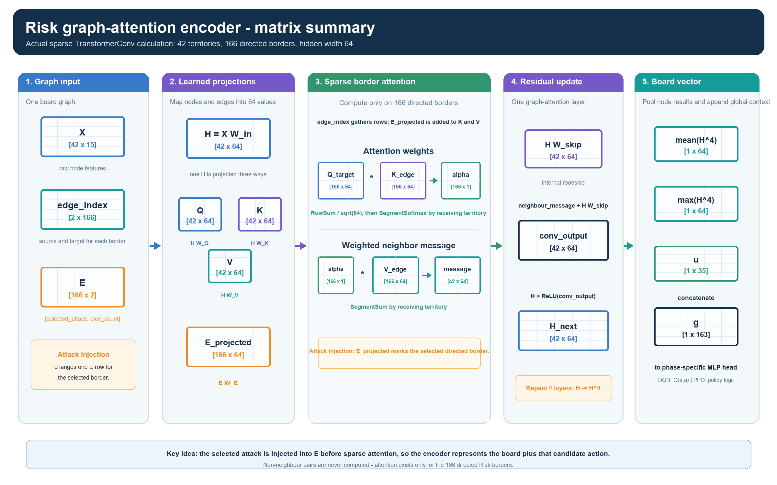
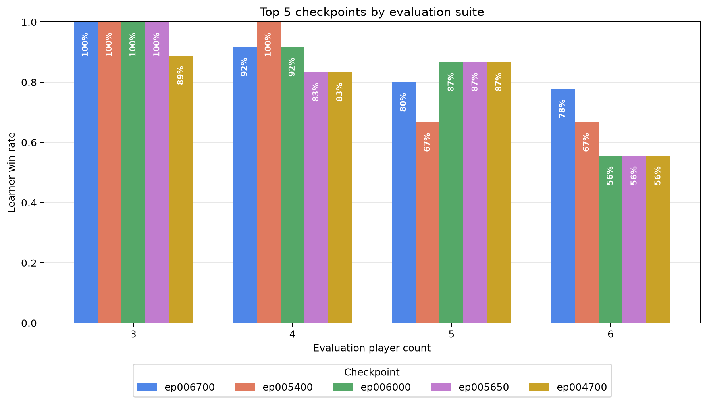
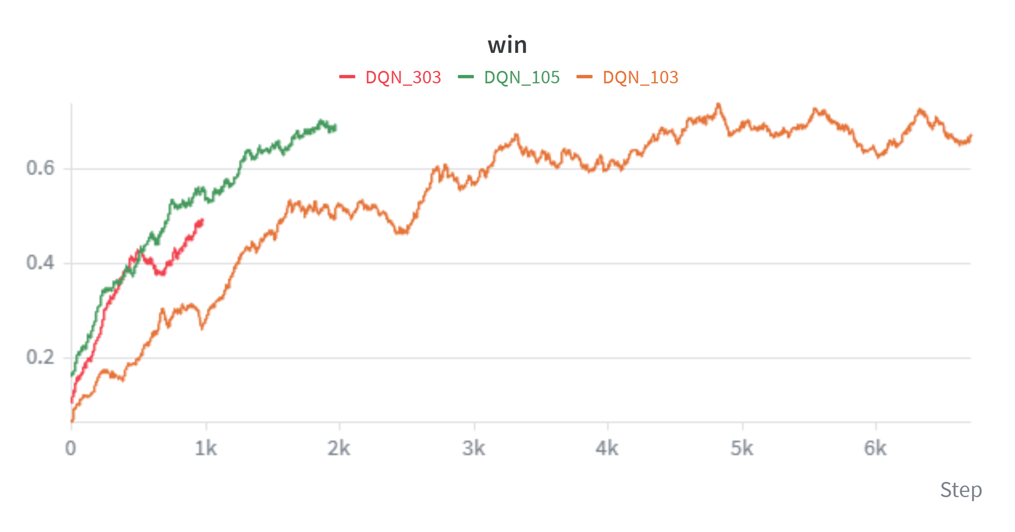
Learning to Play Risk with
Action-Injected Graph Neural Networks
A graph-attention reinforcement-learning approach, compared across DQN, Dueling DQN, and PPO
PROJECT REPOSITORY
Gilad Markman • 2026
Practical Deep Learning for Science • Prof. Eilam Gross
Instead of scoring one enormous fixed move list, the system injects each legal Risk move into the board graph and scores that state–action graph with one shared graph-attention encoder.
1 Board as a graph
2 Inject each legal candidate action
3 Shared GATN encoder + phase heads
Risk's territories and borders are relational: move quality depends on neighbours, armies, and contested continents.
The action becomes part of the graph: an attack changes one border; other phases mark affected territory rows.
Four TransformerConv layers read the injected graph; the current Risk phase selects its small scoring head.
42 territory nodes | 83 borders | 166 directed edges
X [42 x 15] E [166 x 2] u [1 x 35]
How action injection changes sparse attention
DQN_103 evaluated across 3–6 players
Only the 166 directed Risk borders receive attention. An attack changes one selected edge row; reinforce, occupy, and fortify change affected node rows.
54 games / checkpoint
3 seeds · every learner seat
ε = 0 · 2,000-step cap
A legal move is represented as an injected graph feature, allowing one shared encoder to score the state–action pair together.
Latest ep006700
46 / 54 wins = 85.2% · 0 timeouts
Top 5 checkpoints; fixed checkpoint-selection suite.
E [166 x 2] -> E_projected -> K_edge / V_edge -> segment softmax
Results: matched learner comparison
DQN shows the current training curve; Dueling DQN and PPO remain clearly labelled layout placeholders.
DQN
Dueling DQN
PPO
Current DQN data
Temporary placeholder - DQN data
Temporary placeholder - DQN data
Notes:
[Sources]
Content and local visual assets adapted from Docs/Poster.md.
Assets: Assets/RiskMap/image.png; Assets/RiskMap/map_graph_nodes_edges.png; Assets/RiskMap/partial_graph_attributes.png; Assets/RiskMap/network_phase_heads_v2.png; Assets/encoder_matrix_summary.png; Assets/DQN Win.png (current DQN data, intentionally duplicated in the Dueling DQN and PPO slots only as clearly labelled temporary layout placeholders).
[Sources]
DQN_103 checkpoint chart: Checkpoints/DQN_103/evaluations/top5_checkpoint_win_rates_all_player_counts.png.
Evaluation facts: Checkpoints/DQN_103/evaluations/checkpoint_eval_ep006200_to_006700.json (54 games/checkpoint, 3 seeds, every learner seat, epsilon 0, 2,000-step cap; ep006700 46/54 wins and zero timeouts).
Method claim: Docs/ActionGraphBuilder.md and Docs/GraphAttentionNetwork.md.
[Sources]
QR target: https://github.com/MarkmanGilad/RISK.
GitHub logo: Assets/GitHub_Lockup_White.png from GitHub official brand package https://brand.github.com/GitHub_Logos.zip.
[Sources]
Weizmann Institute of Science logo: user-provided file codex-clipboard-94f0a745-03d8-4df6-8fe6-056114cf70b0.png.

